Slide 1
Machine Learning Services
for SQL Server
Buck Woody – Applied Data Scientist
http://linkedin.com/in/buckwoody
Notes:
Main page - http://cortanaanalytics.com
To begin this module, you should have:
Basic Math and Stats skills
Business and Domain Awareness
General Computing Background
NOTE: These workbooks contain many resources to lead you through the course, and provide a rich set of references that you can use to learn much more about these topics. If the links do not resolve properly, type the link address in manually in your web browser. If the links have changed or been removed, simply enter the title of the link in a web search engine to find the new location or a corollary reference.

Slide 2
Welcome!
Download the Course From:
http://
Notes:
The Instructor will show you where to get the assets for this course.
You can use a Virtual Machine, your local workstation, or a VM in Azure tom complete the labs. The installation and configuration information follows – this takes about 30 minutes total.

Slide 3


Lab
Workstation Setup
Notes:
In this lab we’ll get your system ready for the course. Note that you can follow these instructions for a production system as well, but you should read and understand your organization’s requirements prior to doing that.
You can use Windows Azure to set up a Virtual Machine with SQL Server already installed and licensed. More here: https://mva.microsoft.com/en-us/training-courses/sql-server-in-azure-virtual-machines-developer-jump-start-14240#!
If you have not installed SQL Server 2017 on your system, click https://www.microsoft.com/en-us/evalcenter/evaluate-sql-server-2017-ctp/ to download it.
Run the setup program to start the SQL Installer
Click Accept > after you have read the license terms
On the Feature Selection page, select: Machine Learning Services (In-Database) for SQL Server 2017
Choose both R and Python
On the page, Consent to Install Microsoft R Open >, click Accept.
On the page, Consent to Python >, click Accept.
Click Install to proceed with the installation
Download and install SQL Server Management studio: https://msdn.microsoft.com/en-us/library/mt238290.aspx
Next, Run SSMS, connect to your server, and open a new query window.
Then execute the following statements to enable your instance to run scripts in SQL Server.
EXEC sp_configure 'external scripts enabled', 1;
RECONFIGURE WITH OVERRIDE

Slide 4

Learning Objectives
Understand how to create an ML Solution
Understand the R and Python Languages and where they are appropriate
Understand the Microsoft ML Platform and its capabilities
Set up and use the server and various client tools for an ML environment
Know how to operationalize SQL Server ML Services environment
Notes:
At the end of this Course, you will:
Understand how to create an ML Solution
Understand the R and Python Languages and where they are appropriate
Understand the Microsoft ML Platform and its capabilities
Set up and use the server and various client tools for an ML environment
Know how to operationalize SQL Server ML Services environment

Slide 5
Machine Learning
Notes:
Five-Minute Guide to Machine Learning: https://blogs.msdn.microsoft.com/buckwoody/2017/10/24/the-five-minute-guide-to-machine-learning/

Slide 6
Machine Learning Capabilities
Which category
(Classification)
How much/many
(Regression)
Which group
(Clustering,
Recommender)
Is it odd
(Anomaly)
Which action
(Reinforcement Learning)
Notes:
Choosing an Algorithm for Machine Learning: https://azure.microsoft.com/en-us/documentation/articles/machine-learning-algorithm-choice/
Regression: Predict a real value for each item (stock/currency value, temperature). – How much/how many?
Classification: Assign a category to each item (Chinese | French | Indian | Italian | Japanese restaurant). – Which Category?
Clustering/Recommendation: Partition items into homogeneous groups (clustering twitter posts by topic). – Which Groups?
Anomaly: Identify when something unexpected happens. – Is this weird?
Reinforcement Learning: Make an appropriate action for some new data. – Which action?

Slide 7
Machine Learning Algorithms
Split into two main categories:
Supervised learning
Predicting the future
Learn from known past examples to predict future
Labels provided
Unsupervised learning
Making sense of data
Understanding the past
Learning the structure of data
Labels no provided
Notes:
Algorithm Documentation: https://msdn.microsoft.com/library/dn905974.aspx
Exploring: https://azuremlsimpleds.azurewebsites.net/simpleds/

Slide 8
The Data Science Process and Platform
Notes:
This process largely follows the CRISP-DM model - http://www.sv-europe.com/crisp-dm-methodology/

Slide 9
The Team Data Science Process
Business Understanding
Define Objectives
Identify Data Sources
Data Acquisition and Understanding
Ingest Data
Explore Data
Modeling
Feature Selection
Create and Train Model
Deployment
Customer Acceptance
Operationalize
Testing and Validation
Update Data
Handoff
Re-train and re-score
Notes:
https://azure.microsoft.com/en-us/documentation/articles/data-science-process-overview/
A complete process diagram is here - https://azure.microsoft.com/en-us/documentation/learning-paths/cortana-analytics-process/
Some walkthrough’s of the various services - https://azure.microsoft.com/en-us/documentation/articles/data-science-process-walkthroughs/
An integrated process and toolset allows for a more close-to-intent deployment
Iterations are required to close in on the solution – but are harder to manage and monitor
Data Science Blog - https://buckwoody.wordpress.com/

Slide 10
The SQL Server ML Services Platform
Data Acquisition and Understanding
Modeling
Business Understanding
Customer Acceptance
Deployment
SSIS
R Services
bcp
R Services
Templates and Gallery
SSIS
SQL/R/Python
Reporting Services
Reporting Services
Blob Storage
Extended Properties
Python Services
Python Services
Web Endpoints
Blob storage
Reporting Services
Notes:
More on this architecture: https://docs.microsoft.com/en-us/sql/advanced-analytics/architecture-overview-machine-learning?view=sql-server-2017

Slide 11
An Introduction to R
Notes:
Video Introduction to R - https://mran.revolutionanalytics.com/documents/what-is-r/

Slide 12

R Programing and Environment
Data understanding/exploration
Statistical analysis
Data “wrangling”
Machine Learning
Graphical presentation
Text analysis
Open Source “lingua franca”
Ecosystem
Analytics, Computing, Modeling
7000+ Algorithms, Test Data & Evaluations
Notes:
R resources - https://msdn.microsoft.com/en-us/microsoft-r/microsoft-r-more-resources
R Links - http://www.datasciencecentral.com/m/discussion?id=6448529%3ATopic%3A280135
Primary Microsoft R Site - https://msdn.microsoft.com/en-us/microsoft-r/index
Supported Platforms for Microsoft R Server - https://msdn.microsoft.com/en-us/microsoft-r/rserver-install-supported-platforms
Book and Series – http://dacrook.com/introduction-to-microsoft-r-open/
Microsoft R Client - https://msdn.microsoft.com/en-us/microsoft-r/index#mrc
Microsoft R Server - https://msdn.microsoft.com/en-us/microsoft-r/index#mrs
SQL Server R Services - https://msdn.microsoft.com/en-us/microsoft-r/index#sqlr
HDInsight SparkR - https://azure.microsoft.com/en-gb/services/hdinsight/apache-spark/

Slide 13
SQL
SQL and R Contrasted
R
Client/Server
Database Objects
DML, DDL
DCL
Declarative Code
Data Types ~ 30
Interactive Environment
Data Structures
Functions
Libraries (Packages)
Functional Code Flow
Data Types ~ 9
Notes:
Learn SQL - http://www.w3schools.com/SQl/default.asp
Try R, with a great interface - http://tryr.codeschool.com/levels/1/challenges/22
R and Statistics Intro - https://www.youtube.com/watch?v=xb5P5xdcr2U&feature=youtu.be&a
R Online - http://www.tutorialspoint.com/r_terminal_online.php
Using R to explore data - http://www.analyticsvidhya.com/blog/2015/10/cheatsheet-11-steps-data-exploration-with-codes/
Quick R Intro - http://www.datasciencecentral.com/m/blogpost?id=6448529%3ABlogPost%3A112754
Creating a recommender engine in R – http://www.analyticbridge.com/profiles/blogs/build-basic-recommendation-engine-using-r
Visualizations cheat-sheet in R - http://www.datasciencecentral.com/forum/topics/cheat-sheet-data-visualization-with-r?groupUrl=tutorials
Data Science Blog - https://buckwoody.wordpress.com/

Slide 14
R Primary Concepts
Functions
Getting help
Variables and Functional Programming
Package Management
Data Types
Vector - A single-line sequence of one datatype
List - An ordered collection of objects, allowing a variety of (possibly unrelated) objects under one name
Matrix - A multi-line sequence of the same length and datatype
Array - Like a Matrix, but with more dimensions
Dataframe - Table-like structure
Notes:
Basic Functions
Quantitative Analysis
Qualitative Analysis
Predictive Analytics
Creating your own functions
R Data Structures from Advanced R by Hadley Wickham - http://adv-r.had.co.nz/Data-structures.html
Factors - https://www.tutorialspoint.com/r/r_factors.htm
R Packages - http://www.dummies.com/programming/r/how-to-install-load-and-unload-packages-in-r/ and https://cran.r-project.org/doc/manuals/R-admin.html#Add_002don-packages
Book on Creating your own R Packages - http://r-pkgs.had.co.nz/
A useful set of R packages -https://support.rstudio.com/hc/en-us/articles/201057987-Quick-list-of-useful-R-packages
R Packages supported by Azure Machine Learning -https://msdn.microsoft.com/en-us/library/mt741980.aspx
R Package Management for SQL Server R Services -https://msdn.microsoft.com/en-us/library/mt790486.aspx
Scaling R Packages - https://msdn.microsoft.com/en-US/library/mt637368.aspx
Data Science Blog - https://buckwoody.wordpress.com/

Slide 15
Category | Library Name
Data Manipulation | dplyr
 | Data.table
 | lubridate
 | jsonlite
Graphic Displays | Ggplot2
 | lattice
 | Corrplot
HTML Widgets | ggvis
 | plotly
 | rCharts
 | DataTables
Reproducible Research | knitr
 | Rmarkdown
 | slidify
Machine Learning | caret
 | Prophet
 | DataRobot
 | LightGBM
 | xgboost
 | mlr

Slide 16
Lab
Introduction to the R Language
Notes:
In this lab you’ll start using the R language. We won’t focus on SQL Server R just yet, but instead do a few simple R commands to get used to what you can do in the language.
TODO: Small R Tutorial

Slide 17
An Introduction to Python
Notes:
Video Introduction to R - https://mran.revolutionanalytics.com/documents/what-is-r/

Slide 18

Python Programing and Environment
General Purpose
Data understanding/exploration
Data “wrangling”
Machine Learning
Graphical presentation
Interop
Open Source “lingua franca”
Ecosystem
Analytics, Computing, Modeling
7000+ Algorithms, Test Data & Evaluations
Notes:
TODO: Python overviews

Slide 19
Python Primary Concepts
Versions
Commands vs Functions
Program Flow and Spacing
Variables
Operators
Modules and Packages
Numpy
Pandas
ScikitLearn
Notes:
TODO: Primary Python Concepts
Data Science Blog - https://buckwoody.wordpress.com/

Slide 20
Library Name | Type
1. NumPy | Data wrangling
2. SciPy
3. pandas
4. StatsModels | Statistics
5. matplotlib | Visualization
6. seaborn
7. plotly
8. bokeh
9. pydot
10. scikit-learn | Machine learning
11. XGBoost / LightGBM / CatBoost
12. eli5
13. TensorFlow | Deep learning
14. PyTorch
15. Keras | Deep learning
16. dist-keras / elephas / spark-deep-learning | Distributed deep learning
17. NLTK | NLP
18. gensim
19. spaCy
20. scrapy | Data scraping

Slide 21
Lab
Introduction to the Python Language
Notes:
In this lab you’ll start using the Python Language. We’re making use of a “fork” of this site: https://www.learnpython.org/ so that we can run the lab offline. It’s recommended that you also take the course on that site.
TODO: Small Python Tutorial

Slide 22
A Practical Example Of an ML Process and Platform using SQL Server
Notes:
This process largely follows the CRISP-DM model - http://www.sv-europe.com/crisp-dm-methodology/

Slide 23
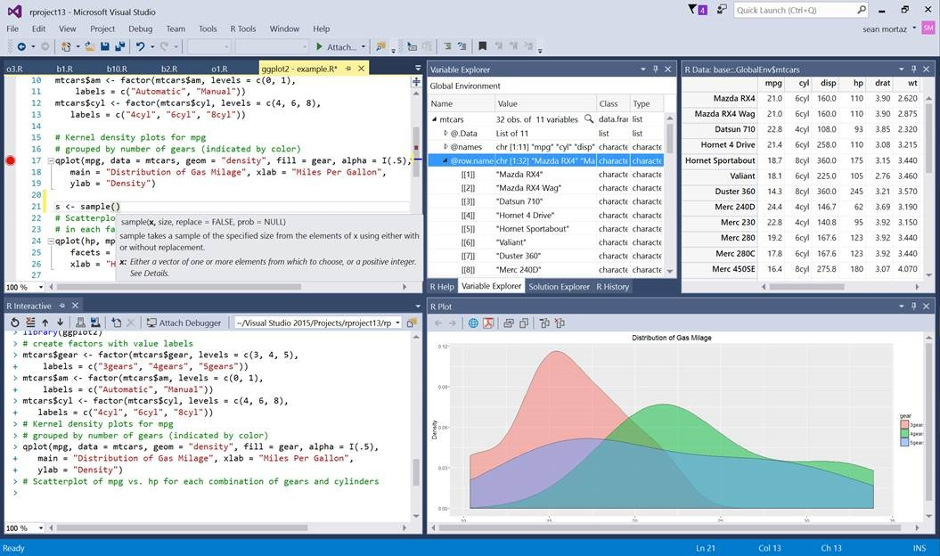

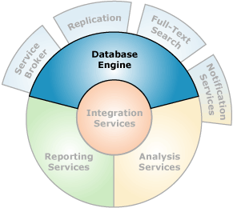
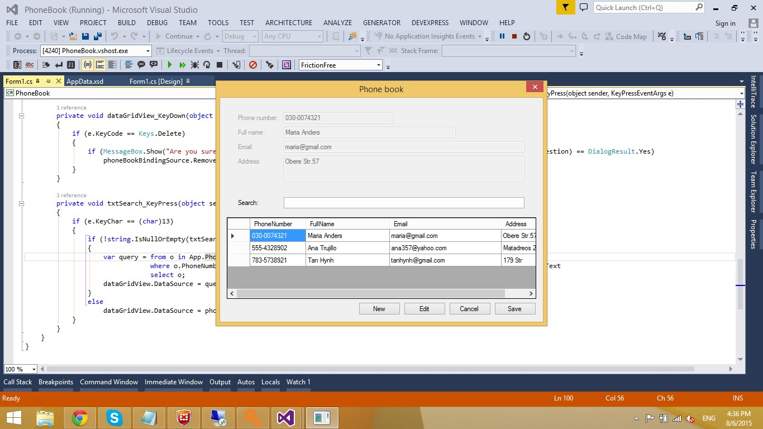
Microsoft ML Services in SQL Server
EXEC sp_execute_external_script
@language =N'R',
-- SQL Part (sends to @script)
@input_data_1 =N 'SELECT 1 as Installed',
-- ML Part (gets @input_data_1)
@script=N'OutputDataSet<-InputDataSet'
WITH RESULT SETS
(([Installed] int not null));
GO
Launchpad
Microsoft ML Server
Notes:
Primary Documentation and training - https://docs.microsoft.com/en-us/sql/advanced-analytics/what-is-sql-server-machine-learning?view=sql-server-2017
Great set of resources - https://www.r-bloggers.com/r-and-sql-server-articles/amp/
Data Science Blog - https://buckwoody.wordpress.com/

Slide 24
Phase One - Business Understanding
Notes:
In Phase

Slide 25
Phase Two – Data Acquisition and Understanding
Notes:
In Phase

Slide 26
Phase Three - Modeling
Notes:
In Phase

Slide 27
Phase Four - Operationalization
Notes:
In Phase

Slide 28
Configuration and Operation
Planning
Specific Environments
File Locations
Services and Background Processes
Package Management
DeployR Planning
Notes:
Setting up R Services - https://msdn.microsoft.com/en-us/library/mt696069.aspx
Features and Tasks - https://msdn.microsoft.com/en-us/library/mt590811.aspx
Differences in Features - https://msdn.microsoft.com/en-us/library/mt721284.aspx
Installing on VM’s - https://msdn.microsoft.com/en-us/library/mt748179.aspx

Slide 29
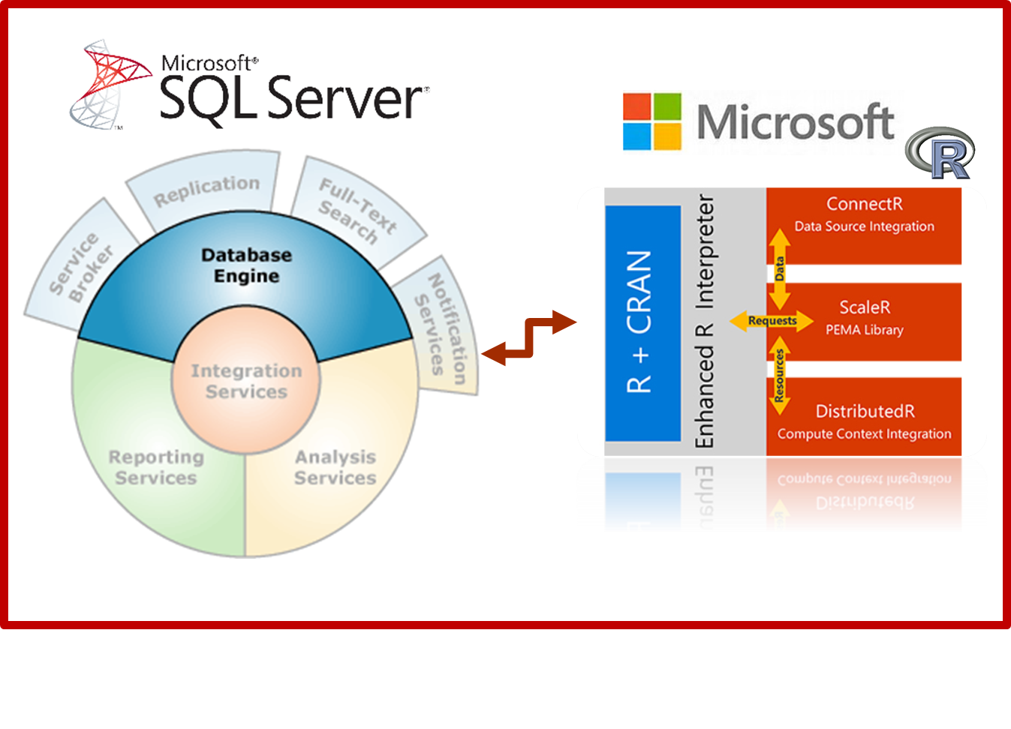
T-SQL and R Interaction
EXEC sp_execute_external_script
@language =N'R',
-- SQL Part (sends to @script)
@input_data_1 =N 'SELECT 1 as Installed',
-- R Part (gets @input_data_1)
@script=N'OutputDataSet<-InputDataSet'
WITH RESULT SETS
(([Installed] int not null));
GO
Notes:
Components and Architecture - https://msdn.microsoft.com/en-us/library/mt709082.aspx (with graphics)

Slide 30
Implementation Considerations
Coordinating with the R professional
Best Practices
Notes:
Managing and monitoring R Solutions for SQL Server - https://msdn.microsoft.com/en-us/library/mt590866.aspx
Upgrade and Installation - https://msdn.microsoft.com/en-us/library/mt653951.aspx
Considerations - https://msdn.microsoft.com/en-us/library/mt590540.aspx

Slide 31
Phase Five – Customer Handoff
Notes:
In Phase

Slide 32
Performance and Monitoring
Performance considerations
Monitoring
Tuning
Notes:
Extended Events for SQL Server R Services - https://msdn.microsoft.com/en-us/library/mt628054.aspx

Slide 33
Security and Governance
Principals
Securables
Notes:
Security Overview - https://msdn.microsoft.com/en-us/library/mt709078.aspx

Slide 34
A More complex example
https://mva.microsoft.com/ebooks/
Notes:
Complete introduction - https://msdn.microsoft.com/en-us/microsoft-r/microsoft-r-getting-started
Optional - https://docs.microsoft.com/en-us/sql/advanced-analytics/tutorials/sqldev-in-database-advanced-analytics-for-sql-developers
Optional - https://docs.microsoft.com/en-us/sql/advanced-analytics/tutorials/walkthrough-data-science-end-to-end-walkthrough
Optional -https://gallery.cortanaintelligence.com/Tutorial/Predictive-Maintenance-Template-with-SQL-Server-R-Services-1
More resources:
https://msdn.microsoft.com/en-us/microsoft-r/microsoft-r-more-resources
Revolutions Blog
Microsoft R and SQL Server - https://www.r-bloggers.com/r-and-sql-server-articles/amp/
Blog: Joseph Sirosh, “Making R the Enterprise Standard…”
Getting Started with Microsoft R
Diving In.. Data Analysis in Microsoft R
R Server Technology – Video
R Tools for Visual Studio Sneak Peek
R Tools for Visual Studio Overview
SQL R Services Overview – Youtube
SQL R Services Feature Overview - Youtube
SQL R Services Overview at Build
SQL R Services Tutorial
Channel 9 Video on examples -https://channel9.msdn.com/Shows/Cloud+Cover/Episode-226-Microsoft-R-Server-Solutions
More labs - https://github.com/Microsoft/SQL-Server-R-Services-Samples and https://gallery.cortanaintelligence.com/Collection/ML-Templates-with-SQL-Server-R-Services-1

